Slide 1
GROUP 14
business’s plan
smart mobile
application
小组成员：余彦橦，连冠权

Slide 2
目录
01
Introduction
02
Literature Review

Slide 3
RART 01
市场痛点
年轻人的社交困境

Slide 4
RART 02
产品核心
由线上到线下

Slide 5
RART 03
市场分析

Slide 6
RART 04
营销策略

Slide 7
RART 05
总结与展望

Slide 8

Research Background
Smoking remains one of the main preventable causes of cancer worldwide
Quitting smoking is considered a key measure for preventing cancer, but the extent and starting time of reducing cancer risk by quitting smoking still need further exploration
Smoking is closely related to the occurrence of multiple organ malignancies, such as lung cancer, laryngeal cancer, and esophageal cancer

Slide 9


Research Objective
Systematic analysis of the association between smoking cessation and reduced cancer risk
Evaluate its biological mechanisms, epidemiological trends, and temporal changes in different cancer risks after quitting smoking

Slide 10


Significance of the Study
By integrating and analyzing data, investigate the degree of cancer risk reduction after quitting smoking, and determine the key time window for intervention
Provide evidence-based support for public health strategies and clinical smoking cessation guidance
添加小标题
Exploring population differences in the effectiveness of smoking cessation, such as racial differences, to optimize personalized smoking cessation plans
添加小标题
单击此处输入你的正文，文字是您思想的提炼，为了最终演示发布的良好效果，请尽量言简意赅的阐述观点；
单击此处输入你的正文，文字是您思想的提炼，为了最终演示发布的良好效果，请尽量言简意赅的阐述观点；

Slide 11
Brief Overview of Methods & Scope and Limitations
Integrate and analyze various related data
Using statistical methods to analyze the quantitative relationship between smoking cessation and cancer risk
Current research has confirmed that quitting smoking can effectively reduce the risk of cardiovascular and respiratory diseases, but there is a lack of comprehensive analysis on the long-term preventive effect of quitting smoking on cancer

Slide 12
RART 02
Market
Analysis
A summary of previous research on a topic.

Slide 13
Preperation for LR diagram
Recognize the role of tables
Review the reasearch and complete the LR diagram
Learn what an LR diagram consists of, how to turn it into an article, and its benefits
Four past studies related to smoking cessation were carefully reviewed, and classroom knowledge was used to complete the form task

Slide 14
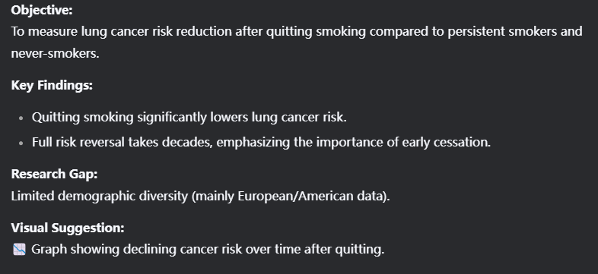
Research literature ONE
Journal of the National Cancer Institute (JNCI)

Slide 15
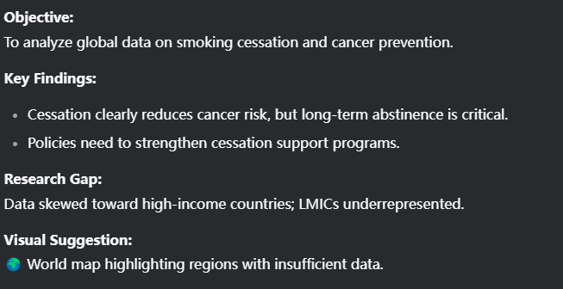
Research literature TWO
World Health Organization Technical Report

Slide 16
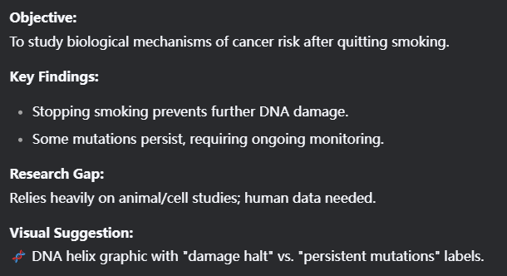
Research literature THREE
International Agency for Research on Cancer

Slide 17
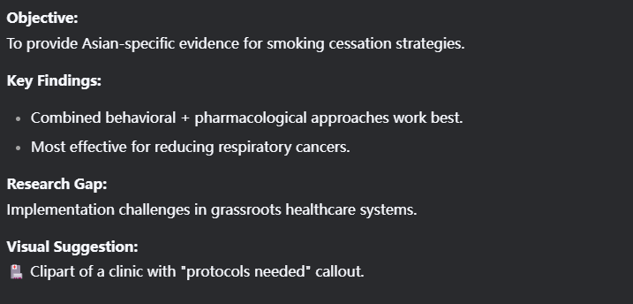
Research literature FOUR
Chinese Journal Study

Slide 18
Thanks for listening
GROUP :2
Academic English
小组成员：余彦橦，黎瀚滔，王小石，黄铭翔，方乐天

